Slide 1
IBM Capstone Project
By – Sashank Kishore

Slide 2
Business problem
To find good location to reside in Boston, Massachusetts with low crime rate and good Asian restaurants.

Slide 3
Data Scraping and Cleaning
COLUMN | DATA TYPE
INCIDENT_NUMBER | Int
OFFENSE_CODE | Int
OFFENSE_CODE_GROUP | String
OFFENSE_DESCRIPTION | String
DISTRICT | String
REPORTING_AREA | String
SHOOTING | String
OCCURRED_ON_DATE | Date
YEAR | Int
MONTH | Int
DAY_OF_WEEK | String
HOUR | Int
UCR_PART | String
STREET | String
Lat | Float
Long | Float
Location | String

Slide 4
Data Preparation
Unwanted columns were removed from the Boston crime data. Rows with no data was removed.
After cleaning the data from first source, it was merged with the second table to get the district name from the district code.

Slide 5
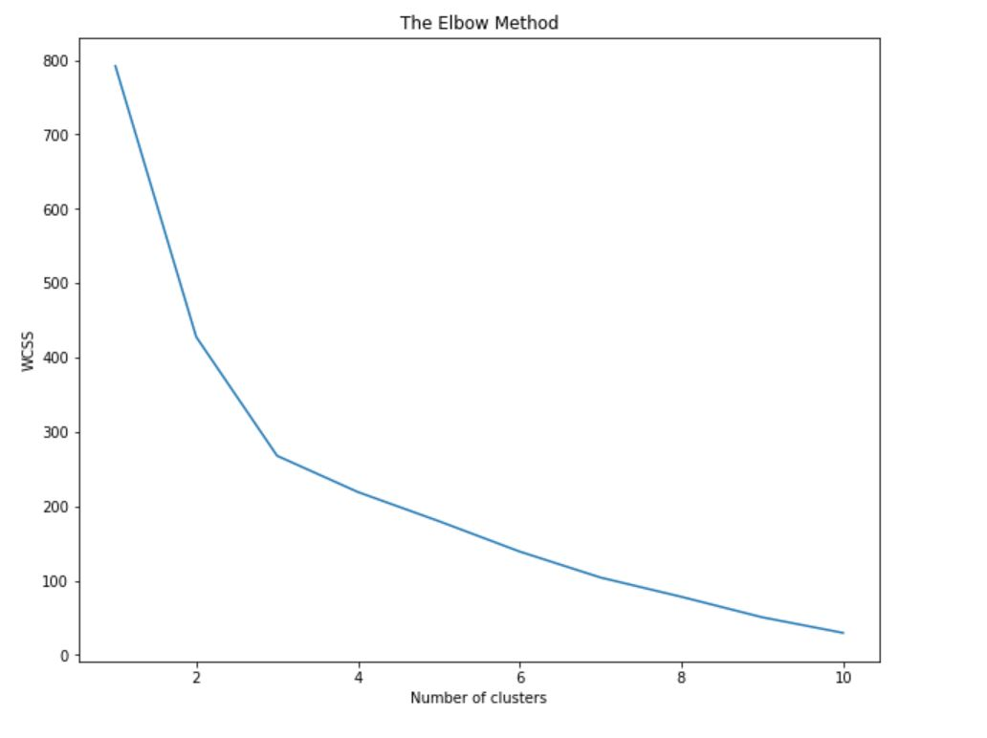
Methodology – K Mean Method
After preparing the data, K Mean Method was used to cluster the data. Using the elbow method.

Slide 6
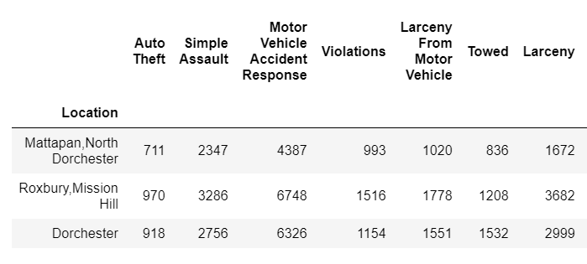
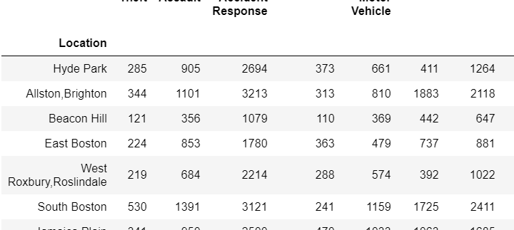
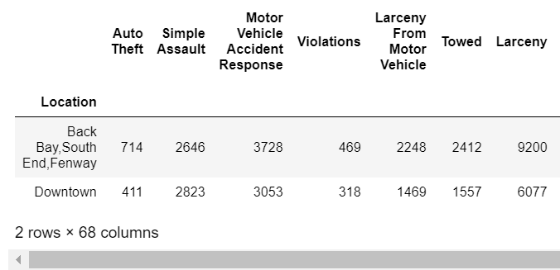
3 Clusters

Slide 7
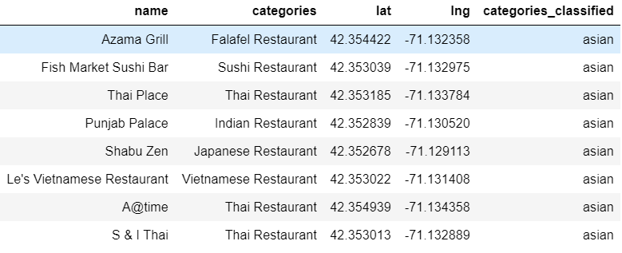
Foursquare
Going through all the districts in cluster 1, we found that Allston, Boston, has most asian restaurants.

Slide 8


